Slide 1
FP&M SETA MANDATORY AND DISCRETIONARY GRANT WORKSHOPS 2023/24
MG-SKILLS PLANNING

Slide 2
SETA GRANT REGULATIONS
Distribution of skills development levy income

Slide 3
SETA GRANT REGULATIONS
The intention of Mandatory Grants is to incentivise employers to:
to plan & implement training for their employees
to create training and work experience opportunities for unemployed people
Mandatory Grant Applications
– Submission due by 30 April
Better alignment with skills development and financial year
Enhanced SETA planning cycle
SSP Annual Update
Earlier Discretionary Funding Windows

Slide 4
SETA GRANT REGULATIONS
Mandatory Grants
Increased monitoring of WSP implementation against Board criteria
Criteria for approval
Evidence requirements
Quality & accuracy standards for WSPs & ATRs
Evidence of consultation and sign-off by labour representative (unless explanation is provided)

Slide 5
WORKPLACE SKILLS PLANNING
The Workplace Skills Plan (WSP),
is one of the most powerful tools delivered to employers through skills development legislation.
It is aimed at business expansion and sustainability.
It is completed by companies with information specific to their business and the sector in which they operate.
The Sector Skills Plan (compiled by the FP&M SETA) is an important resource to be used in the compilation of the WSP
Identify sector trends
Identify Priority Skills and Occupations in High Demand
Identify skills development interventions to address the Country’s Labour Market and curb unemployment

Slide 6
WORKPLACE SKILLS PLANNING
The construction of a WSP plays a major role in several vital areas –
Management and employees enter discussions regarding skills planning in the workplace.
Skills available and skills gaps are identified and discussed in a positive way.
Management has a platform to share the company’s goals with employees, who in turn gain better understanding and more commitment to the process of achieving them.
Companies begin to uncover talents and skills they did not know they had available.

Slide 7
WHO IS ELIGIBLE
A levy paying employer claiming a mandatory grant must
meet the eligibility criteria for the payment of a mandatory grant
An eligible employer -
has registered for skills development levies;
has paid the levies in the prescribed manner (minimum threshold R500k per annum);
has submitted a WSP / PIVOTAL Plan and ATR/PIVOTAL Report within the prescribed timeframes (30 April) that contributes to the relevant SETA SSP
has submitted an Annual Training Report and/or PIVOTAL Training Report, demonstrating some alignment to the previous year’s WSP and/or PIVOTAL Plan

Slide 8
WORKPLACE SKILLS PLANNING
The mandatory grant application consist of the following important sections:
Organisational information
Banking details
Employment summary and Provincial Breakdown
Provides information on the current workforce (including learners)
Workplace Skills Plan
PIVOTAL plan
Planned implementation of PIVOTAL learning programmes e.g. apprenticeships, learnerships, credit bearing skills programmes, work integrated learning, bursary programmes (post school / tertiary qualifications at TVETs/ HEIs)
Non-PIVOTAL plan
Planned implementation of other learning programmes e.g. non-credit bearing skills programmes, in-house training (health and safety, HIV/Aids awareness)

Slide 9
WORKPLACE SKILLS PLANNING
Annual Training Report
PIVOTAL training report
Actual implementation of PIVOTAL learning programmes e.g., apprenticeships, learnerships, credit bearing skills programmes, work integrated learning, bursary programmes (post school / tertiary qualifications at TVETs/ HEIs)
Non-PIVOTAL training report
Actual implementation of other learning programmes e.g., non-credit bearing skills programmes, in-house training (health and safety, HIV/Aids awareness)
Adult Education and Training Plan
Training Committee (list of members) – for medium and large firms only
Sign-off (Authorisation page)

Slide 10
WORKPLACE SKILLS PLANNING
ATR and/or Pivotal Report must reflect all training conducted
During April to March (of the previous financial year)2022-2023
Internally or Externally
The WSP and/or Pivotal Plan must reflect all planned training
Internally or Externally
Planned for April to March (of the current financial year)2023-2024

Slide 11
WORKPLACE SKILLS PLANNING
The WSP/ATR must be duly authorised and signed-off by:
The Internal Training Committee / Skills Development Committee including designated labour representative
Firms employing 50 or more employees; or
The Owner / Chief Executive and designated employee representative
Firms employing less than 50 employees;

Slide 12
WORKPLACE SKILLS PLANNING
Deadline for submissions: on/or before 30 April
Applications to be submitted electronically via LMIS,
Scanned authorisation page and scanned current proof of banking details to be upload to LMIS Original proof of banking details will be required from first time applicants or
if an applicant’s banking details have changed since the previous year’s submission.
Assistance will be supplied to applicants unable to access the LMIS on request
Requests for extension or Anticipated delays to be submitted by 31 March for MG to Skills Planning Division for DG to Projects Division;
subject to approval by Board

Slide 13
SECTORAL PRIORITY OCCUPATIONS AND INTERVENTIONS(PIVOTAL)
The SETA Sectoral Priority Occupations and Interventions (PIVOTAL list) is one of the important data sources used extensively in the compilation of the list of Occupations in High Demand by the Department of Higher Education and Training
In preparation for the compilation of Occupations in High Demand list for 2020,DHET conduct a verification process of the SETA PIVOTAL list
It is against this background that the FP&M SETA prepares this presentation on the methodologies/processes that were used in arriving at the SETA Sectoral Priority Occupations and Interventions (PIVOTAL list) and the List of Occupation in High Demand

Slide 14
VALUE CHAIN CONSIDERATIONS
The 13 sub-sectors FP&M SETA have different and diverse manufacturing processes and products
Linked through value chain e.g.
Forestry as the Primary Sector feeding into the other sub sectors, e.g. timber mills, pole plants, sawmills etc.
Textiles and leather used in clothing, general goods, upholstery, footwear
Wood processed into pulp (for paper or cardboard) or wood products for furniture / building industry.
Textiles and paper used in the printing industry
Close relationship between printing, publishing and print media sector
The value chain approach is beneficial to the FP&M sector:
To address the Occupation in High demand needs (of which there is a significant overlap between the industries) through a consolidated skills development approach
When design expertise is partnered with these industries to enhance their economic performance

Slide 15
PIVOTAL – SPOI SECTORAL PRIORITY OCCUPATION AND INTERVENTIONS LIST
Professional, Vocational, Technical and Academic Learning programmes that result in qualifications or part qualifications registered on the National Qualifications Framework (NQF) that address
- Sectoral Priority Occupations and Interventions which are;
Professional: Learning programmes shall mean programmes that lead to designations that are registered by professional bodies.
Vocational: Learning programmes shall mean noted and artisanal programmes that lead to a trade and/or the National Certificate Vocational (NCV).
Technical: Learning programmes shall mean programmes that are occupationally-directed and registered by the SETA; such programmes include apprenticeships, learnerships and skills programmes.
Academic learning programmes: Shall mean programmes that lead to academic qualifications such as certificates, Higher Certificates, Diplomas and Degrees.

Slide 16
IDENTIFYING PIVOTAL – SECTORAL PRIORITY OCCUPATIONS AND INTERVENTIONS
The fields of data that are completed include the following:
OFO code framework version 21
Occupation (Specialisation, Trade, etc.)
Socio Economic Status
PIVOTAL Programmes
PIVOTAL Programme Name
NQF Level
Number of beneficiaries
For OFO codes are a search field and allows stakeholders to complete either the 6 digits code of the occupation, or the name of the occupation. Both the OFO and the occupation name appear to ensure the code and occupation is perfect matched.
A drop down of the OFO codes and the name of the match to occupation appears in order to ensure alignment to the OFO code.

Slide 17
IDENTIFYING PIVOTAL/SPOI INTERVENTIONS
In the PIVOTAL/SPOI section of the WSP/ATR, companies are asked to complete information on the type of PIVOTAL/SPOI training.
Clarity on what PIVOTAL/SPOI is emphesised during MG/ DG workshops, focus groups and other stakeholder engagement sessions.
The fields here include the type and appropriate/ preferred intervention for the occupation, at a specific NQF level

Slide 18
THE ENVISAGED OUTCOMES FROM THE IDENTIFIED INTERVENTIONS
PIVOTAL/SPOI skills means Professional, Vocational, Technical and Academic Learning programmes that result in qualifications or part qualifications registered on the National Qualifications Framework (NQF) that address OIHD.
It thus envisaged that through the selected interventions the FP&M SETA can:
address the (Occupation in high demand) needs across all its 13 sub-sectors
to ensure the constant creation of a growing skills pool for the necessary professional and technical needs of its sub-sectors to keep the companies within those sector competitive and productive.
Address the urgent skills gaps
Create pathways for new entrants through training programmes that lead to qualifications

Slide 19
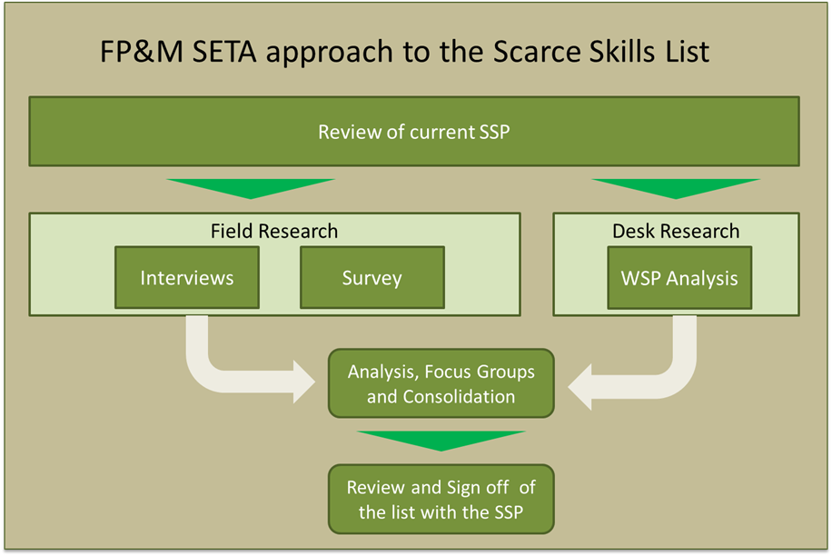
FP&M SETA’S APPROACH TO THE SPOI (PIVOTAL) SKILLS LIST

Slide 20
THE IDENTIFIED OCCUPATIONS THAT ARE PIVOTAL
An important step in compiling the Pivotal list is the vigorous analysis of the data received from all the 13 sub-sectors.
Here the research team ensures that all the fields necessary for reporting are fully and correctly completed by the companies, it considers the logic used to ensure that the companies are applying the correct definition of terms involved.
This is thus an intense process of working on the list and where necessary contacting the specific companies that may have made mistakes to work towards correcting these.
The steps here include:
Verification
Correction
Accuracy checks and
Compilation of list

Slide 21
CRITERIA FOR DETERMINING TOP 50 OR 10 SPOI/PIVOTAL SKILLS LIST
Criteria to be met
SCOPE of the FP&M sector skills needs
Focus group sessions
Literature review
WSP/ATR
analysis
Focus group sessions
one of the strategic objective targets e.g artisan development
In-depth interviews

Slide 22
SETA PIVOTAL/SPOI LIST AND THE SETA’S COMMITMENT SCHEDULE
The FP&M SETA’’s analysis of the WSP/ATR, and other data sources, is to compile and OFO aligned PIVOTAL/SPOI skills list. This list shows the priority skills areas that the FP&M SETA will be committing funding for in that financial period as recorded in the commitment register.
This is achieved through constant alignment with the research done through the Sector Skills Plan and the SETA’s reacting to it through its strategic plan.

Slide 23
Occupational shortages and skills gaps
Occupational shortages and skills gaps
What occupations are HARD-TO-FILL VACANCIES? (It takes longer than 12 months to fill the position)
How many of these occupations are HTFVs?
Why are these occupations hard-to-fill? Reasons (are they skills-related HTFVs or non-skills related HTFVs?)
What are the major SKILLS GAPS in your sector at the major occupational level?
Extent and nature of Supply
What is the extent of occupational
supply in the sector?
What is the state of education and training provision?
What supply problems are firms experiencing?
SPOI/PIVOTAL list
What methods did the SETA employ in identifying occupations in the SPOI/PIVOTAL list? (a small summary of the methodology)
What informed the interventions indicated in the SETA /SPOI/PIVOTAL list?
What are the envisaged outcomes from the identified interventions?
What consultative processes did the SETA use to arrive at the occupations identified in the SPOI/PIVOTAL list?
What are the main findings that informed the PSPOI/IVOTAL list?
What informed the quantities indicated in the SETA SPOI/PIVOTAL list?
Is the SETA SPOI/PIVOTAL list ranked, in order of priority? If so, what informed the ranking of occupations indicated in the SETA SPOI/PIVOTAL list?

Slide 24
IMPLICATIONS FOR: SECTOR SKILLS PLANS
SETA PIVOTAL SKILLS LIST
WSP/ATR received by SETAs and analysed
Labour market information analysed
Demand for skills analysed
Occupation in high demand list compiled and a PIVOTAL list produced
Alignment with SETA Strategic Plan & APP
Source: DHET

Slide 25
ORGANISING FRAMEWORK FOR OCCUPATIONS (OFO V21)
Purpose
To standardise reporting terminology (easier to generate legislated reports)
To report on skills demand and skills supply
Inform the National Guide on occupations/ employment trends.
The OFO is updated every two years:
Version 21 is used for Workplace Skills Plans/ Annual Training Report

Slide 26
Contact Details : GM Mr. PK Naicker – 031 702 442
Johannesburg
Pearl Ngiba– 011-403 1700
PearlN@fpmseta.org.za
Cape Town
Xoliswa Radebe or below number for CT
021-462 0057
Durban
Louise Sagar – 031-702 4482
LouiseS@fpmseta.org.za
Skills Planning Research and Reporting Manager
Sylvia Tsunke – 011 403 1700
sylviat@fpmseta.org.za
Skills Planning & Reporting Coordinator
Sbahle Ndlovu– 011-403 1700
sbahleN@fpmseta.org.za
Skills Planning Specialist
Xoliswa Radebe– 011 – 403 1700
xoliswaR@fpmseta.org.za
Skills Planning Administrator
Thulani Majola – 011 403-1700
thulaniM@fpmseta.org.za
REGIONAL OFFICES
HEAD OFFICE

Slide 27
MG-Skills Planning Presentation: 2023-24
FP&M SETA: Workplace Skills Plan & Annual Training Report 2023/24 LMIS Training, and
OFO Mapping Tool Capacity

Slide 28
WORKPLACE SKILLS PLAN AND ANNUAL TRAINING REPORT 2023/24
There’s 2 Processes of Capturing the WSP/ATR:
Excel upload and direct capturing onto the LMIS system
1. Excel Upload template:
Employee worksheet (Planned and Implemented Training)
Training Interventions worksheet (Information of all Interventions, NQF Level, Pivotal and Non-Pivotal, Cost of training, DG (Y/N)
Training Completed and Planned ( WSP and ATR) (Intervention title, employee intervention status, start and end date, learning mode, appointment section) etc.
POPIA ACT, PLEASE NOTE
The FP&M Seta observes the Popi Act, and we would like to assure our stakeholders that; all information on the template, including employee unit data information, will be treated with strict confidentiality and used for reporting to DHET and research purposes only
By accessing this website /template , I consent to the collection, collation, processing, and storing of such information and the use and disclosure of such information in accordance with this the POPI Act.

Slide 29
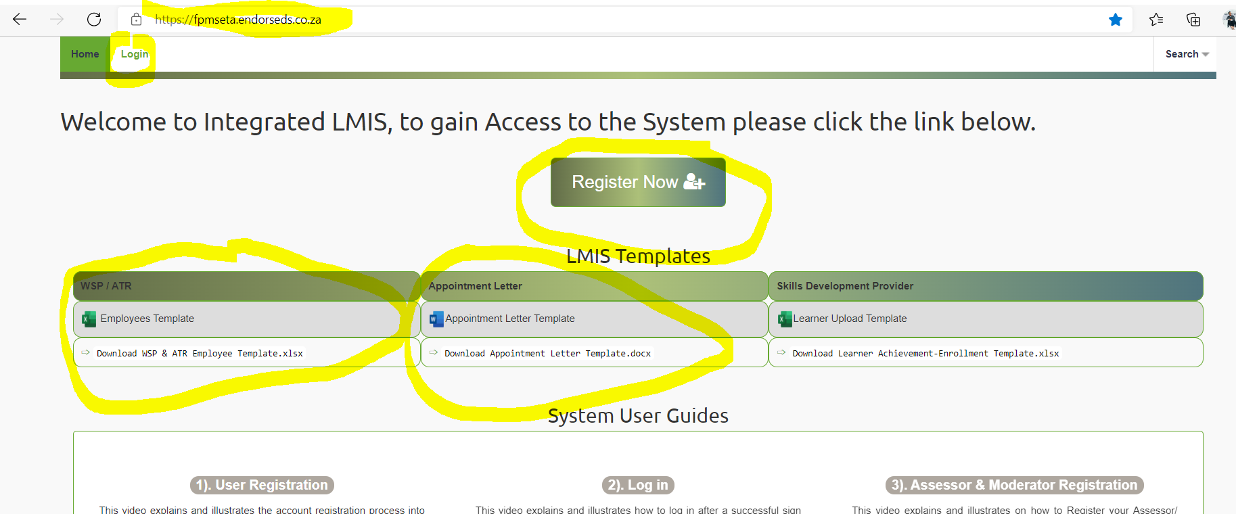
REGISTERING/ LOGIN TO LMIS- PROCESSES
LMIS direct Capturing; Adaptit to take stakeholders through the system
Below is the website landing page

Slide 30
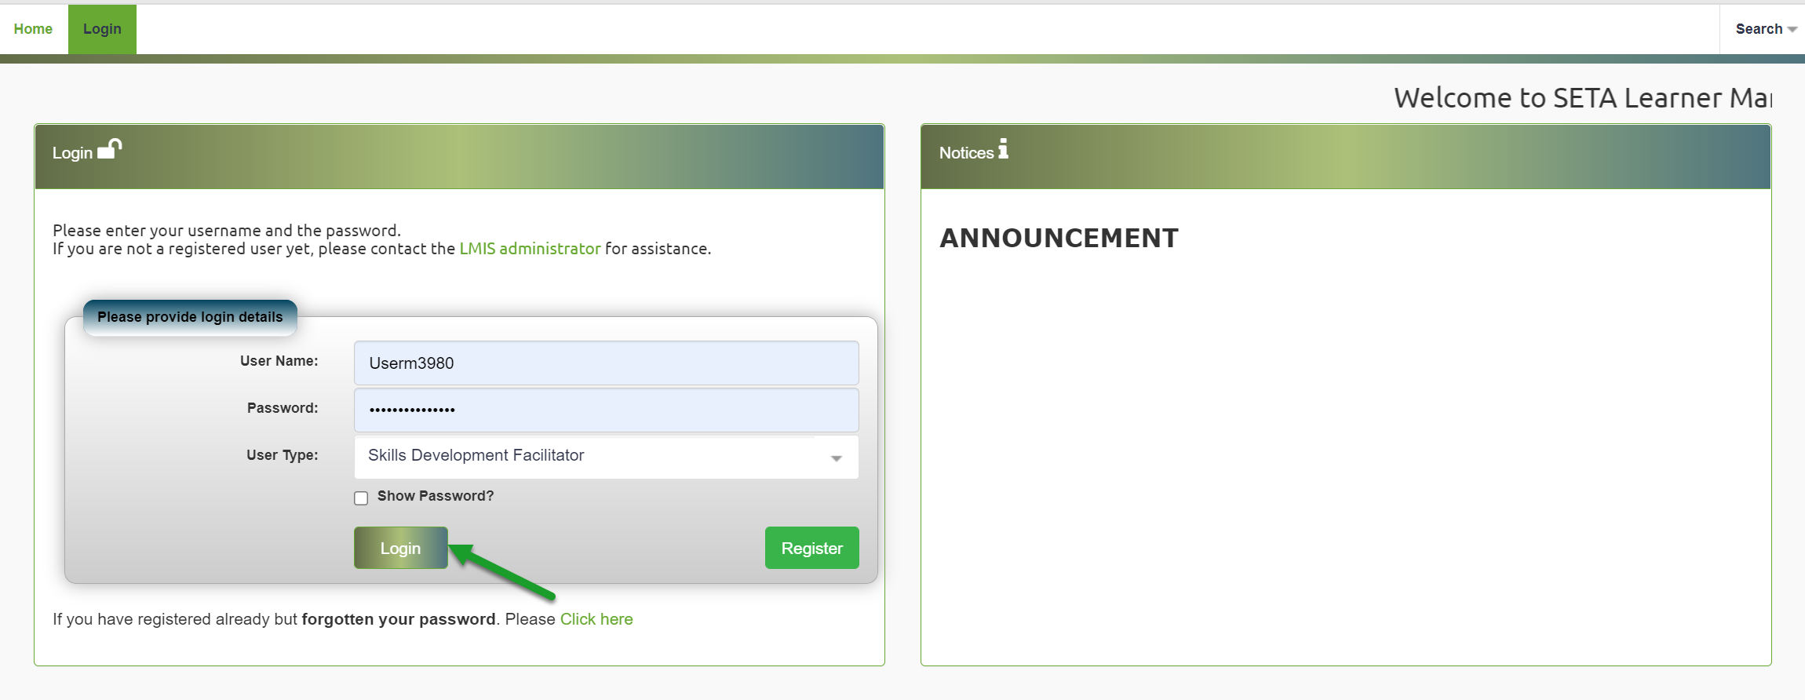
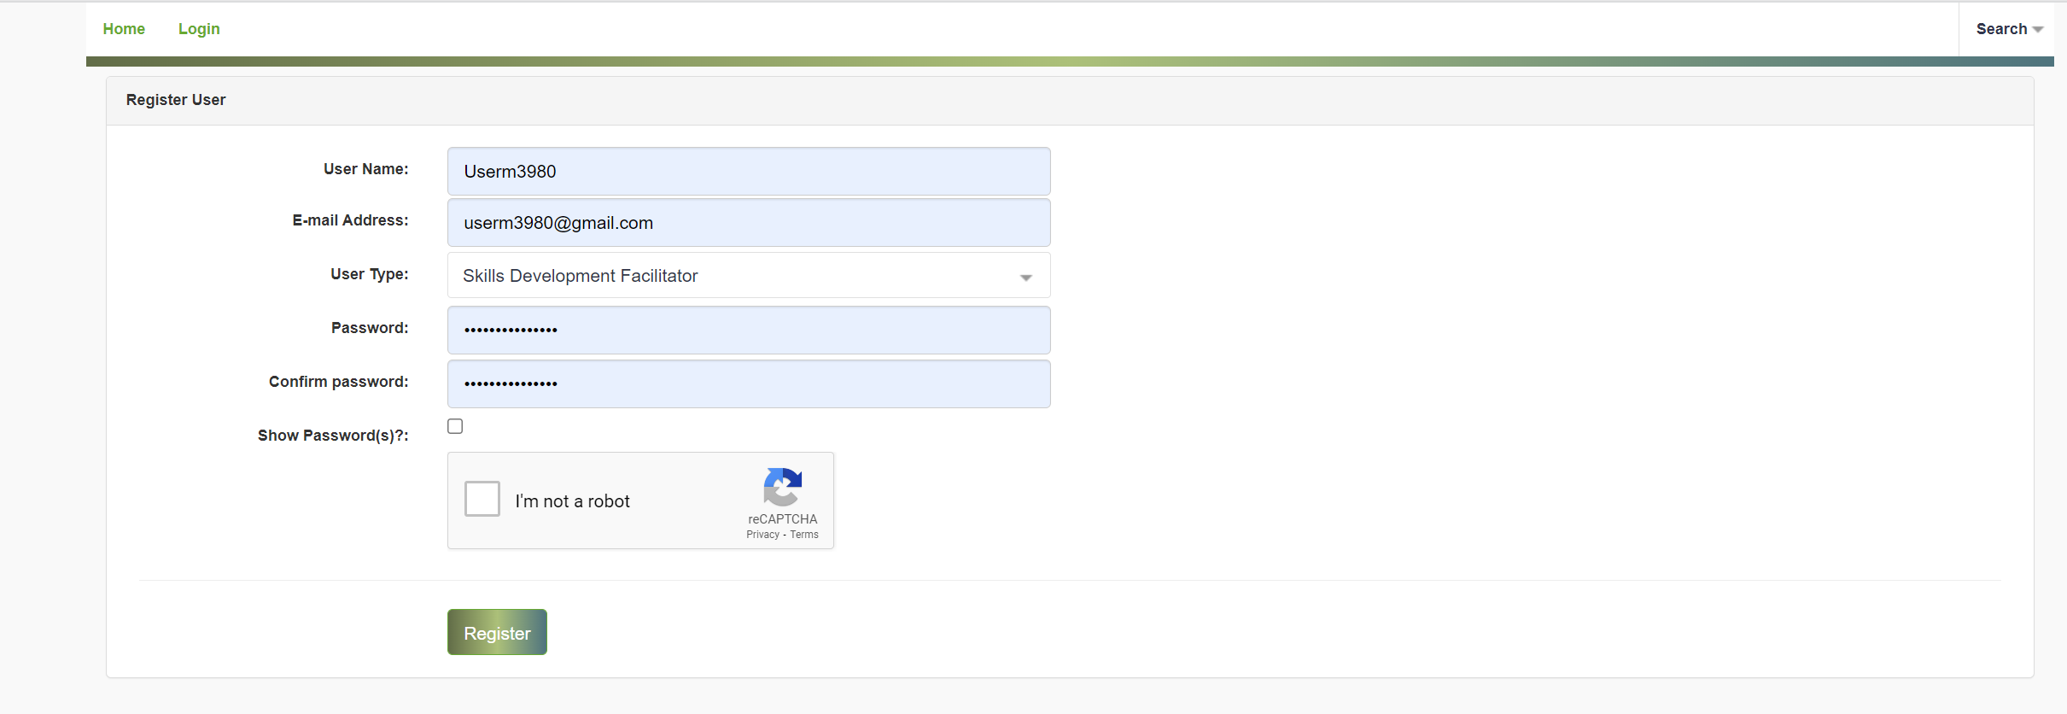
REGISTERING/ LOGIN TO LMIS- PROCESSES

Slide 31
LMIS – PROCESSES
When registering on LMIS for WSP/ATR submission please select “Skills Development Facilitator" on the dropdown,
Based on the Regional application we will approve the SDF registrations as soon as we receive the system notifications that an SDF has registered – All SDF must register an upload a new SDF appointment letter with the correct date 2023/24
The FPM seta staff is available to assist stakeholders on issues related to registering, where to capture and how to upload the excel upload and when encountering system challenges
Please note that it is important to upload an SDF appointment letter from the company-on-company letterhead signed by the Director, CFO, etc. not by the SDF or Administrator or junior staff members.
Do not forget that you will still be required to upload Bank letter (not older than 3 months of submission), signed minutes which reflects the 2022 date and the signed authorisation page

Slide 32
ORGANIZING FRAMEWORK FOR OCCUPATIONS (OFO)VERSION 2021
mapping from job to occupation on the Organizing Framework for Occupations (OFO) identified by SETAs over the years. Leads to incorrect identification of demand of skills
Purpose of the mapping tool would be to assist employers (in all 21 Sectors) with mapping jobs to occupations.
After extensive research and trials, the tool has been developed through partnership of WITS REAL and DHET with SETAs
OFO VERSION 2021.xlsx
Why does the OFO matter?
Mechanism to articulate occupational demand.
If your strategy and purpose is to link skills supply and demand, then at the very least you need to understand which occupations are in demand
OFO links ( at a basic yet critical level) the worlds of education and work
If the PSET system does not understand the nature and extent of demand it cannot provide the right skills to the right people at the right time.
There is a need to improve the quality of mapping to the OFO ( which the tool aims to contribute to) and to think about what a future OFO might look like

Slide 33
WHY DOES THE OFO MATTER CONTINUES,
Getting this right (matching skills supply with skills demand) extremely difficult and complex. Various role players and stakeholders need to take part. Also external structural factors beyond the control of the system.
Despite the above the OFO is a critical (although by no means the sole) mechanism through which occupational demand is articulated and understood.
Accurately mapping jobs to occupations is a critical part of improving the quality of occupational data in the 21 sectors covered by the SETAs.
If the wrong skills are provided to the wrong people at the wrong time it has potentially serious economic and socio-economic consequences. The price paid by disadvantaged groups can be especially high as they are often solely dependent on education and training provided by the state

Slide 34
PURPOSE OF THE ELECTRONIC OFO CODES MAPPING TOOL
The ultimate purpose of the application is to make it simpler and easier for employers to find their occupations on the OFO.
This will ensure that more accurate occupational data is provided to the SETAs.
By providing more accurate data regarding occupations to the relevant SETA the right skills can be provided to employers at the right time.

Slide 35
HOW IS IT DIFFERENT FROM THE OFO SPREADSHEET?
This tool reduces the time it would take for SETAs, employers or anyone mapping jobs to occupations.
It also allows employers to flag if they can’t find their occupation on the OFO. This will allow SETAs and DHET to
take a more proactive approach to updating the OFO.
If the tool is properly marketed (by all 21 SETAs) and widely used it will allow for the generation of extensive data which will indicate the extent to which the current OFO is capturing the nuance and rapidly changing world of occupations in South Africa.
We have established that it could it take up to 2 to 3 hours to map one job to the OFO. The accuracy of the mapping is also often questionable

Slide 36
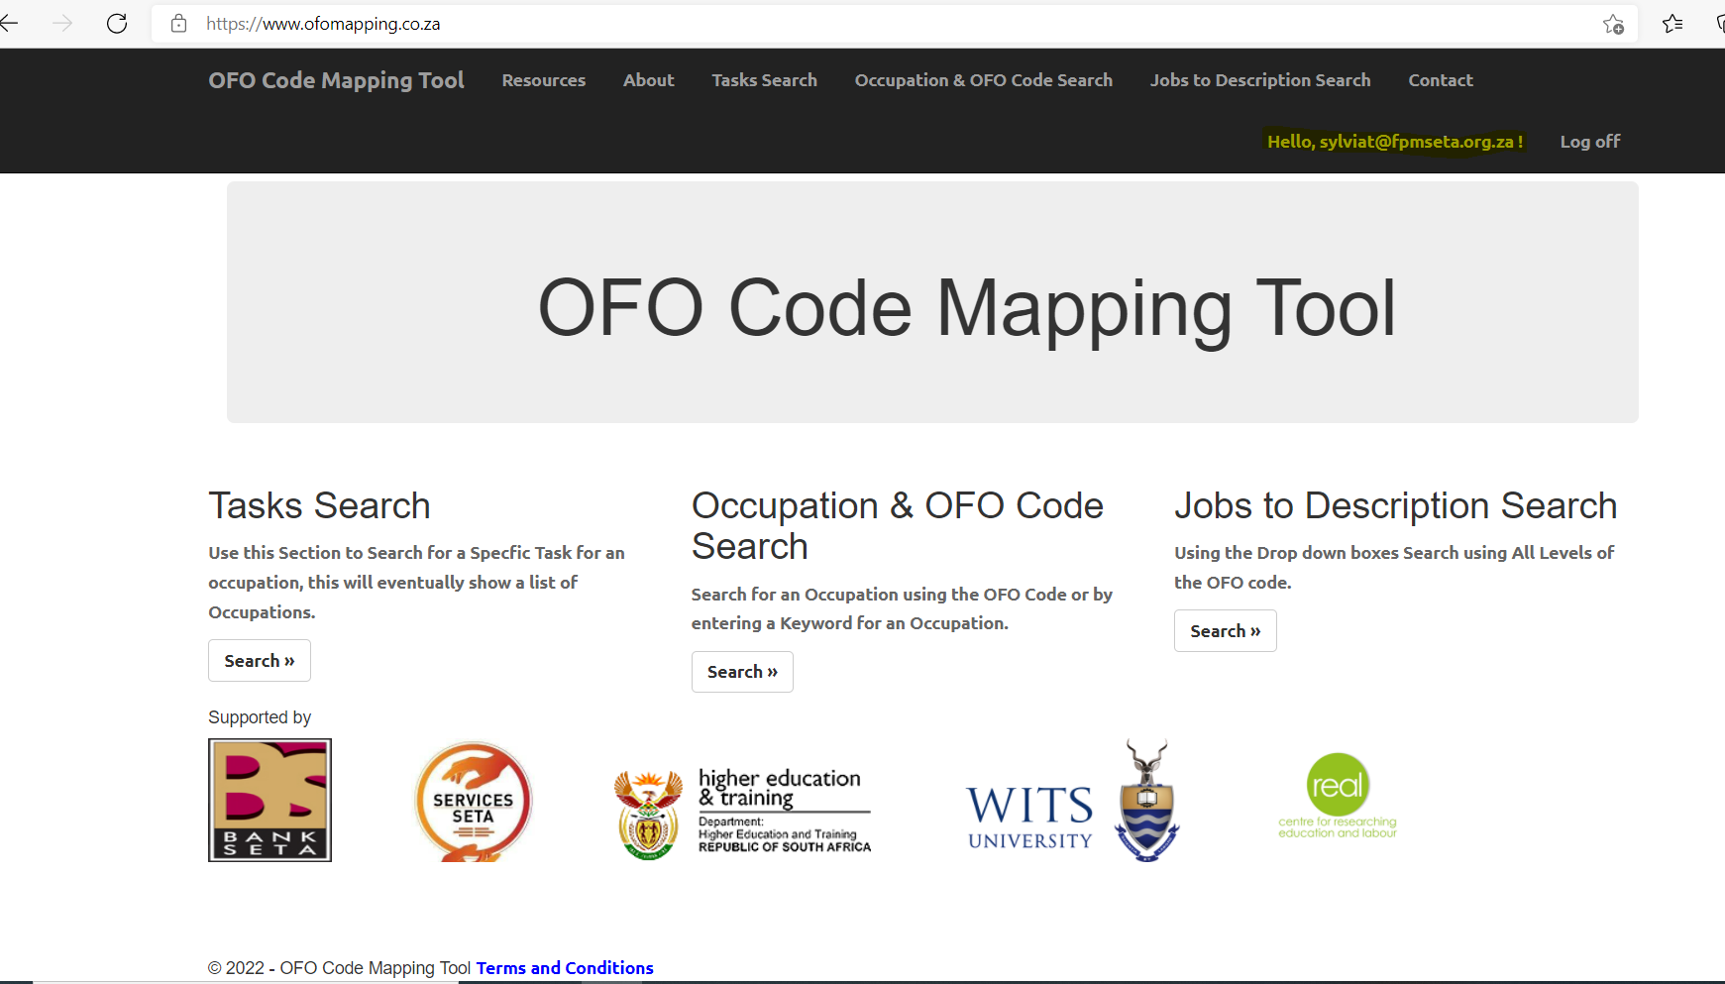
OFO MAPPING TOOL LINK
www.ofomapping.co.za

Slide 37
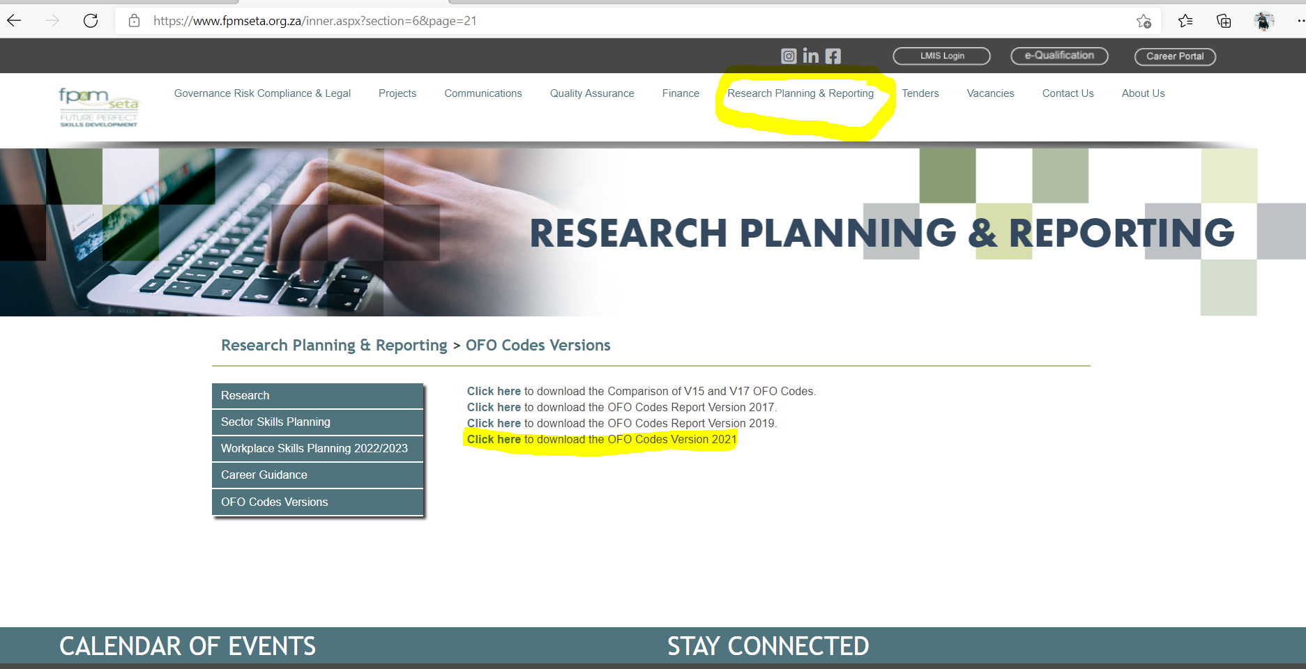
OFO CODES VERSIONS ON FP&M SETA WEBSITE

Slide 38
Thanks You

